Slide 1
User Guide

Slide 2
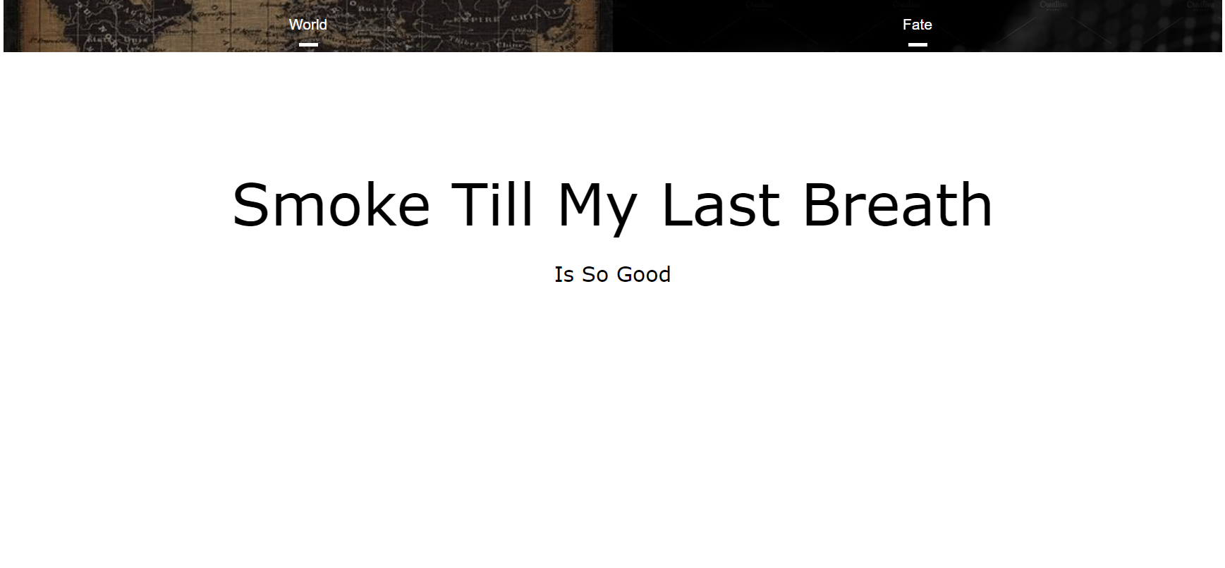
Choose subpart title to start

Slide 3
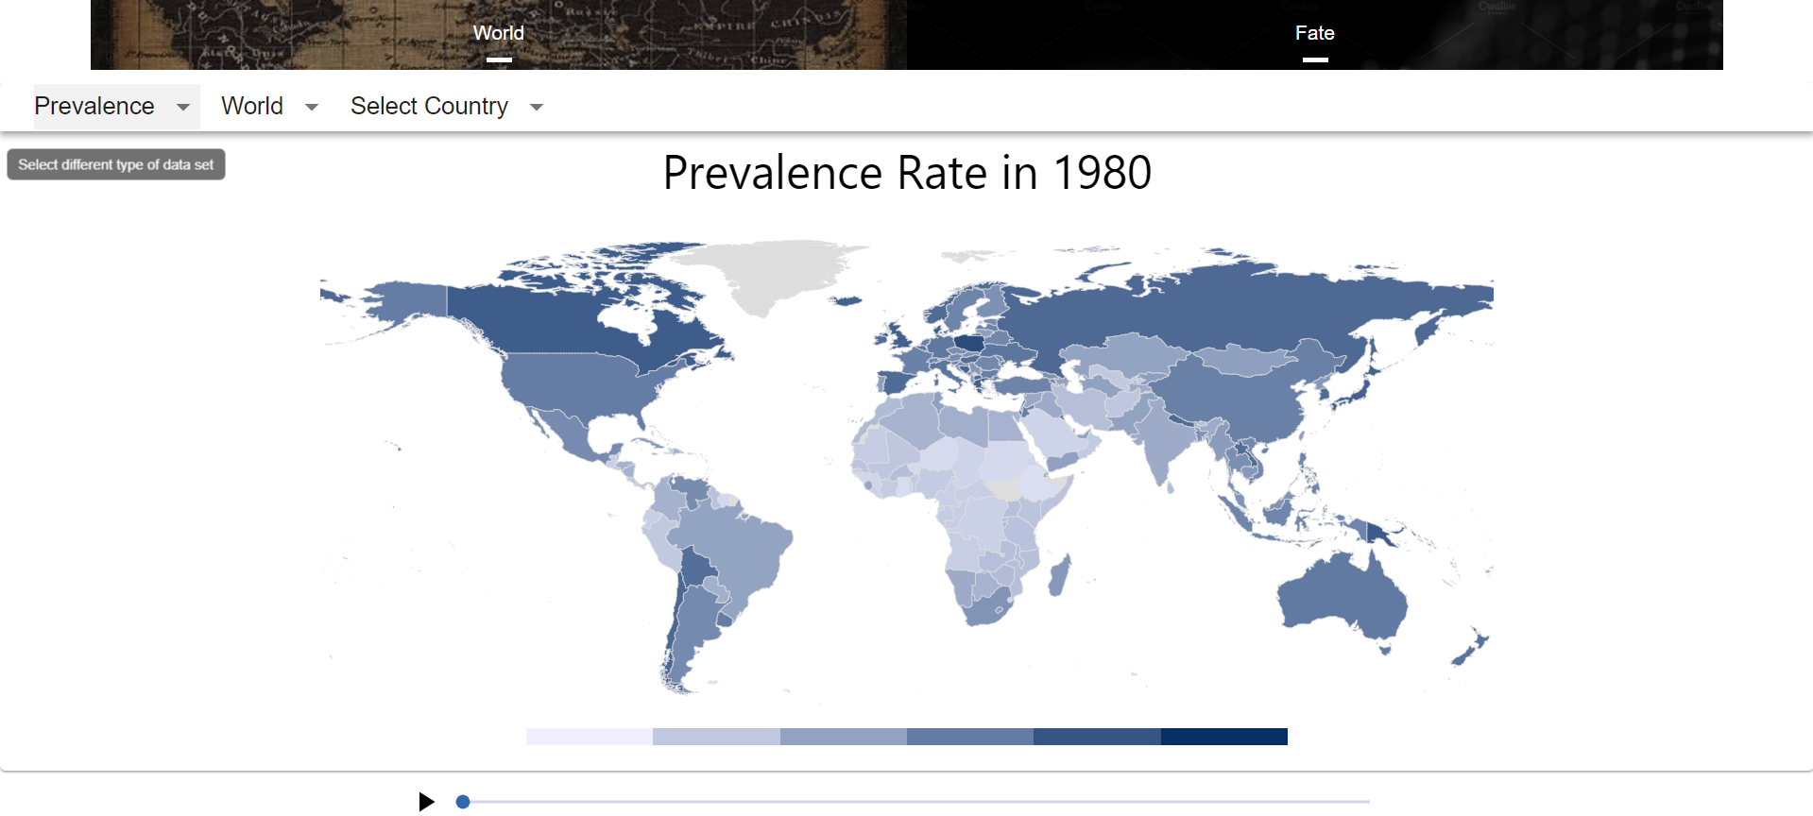
Select region
Select type of data
Select to show country breakdown

Slide 4
Legend of percentage
Press the auto-play button to see the changes on map over time
Timeline

Slide 5
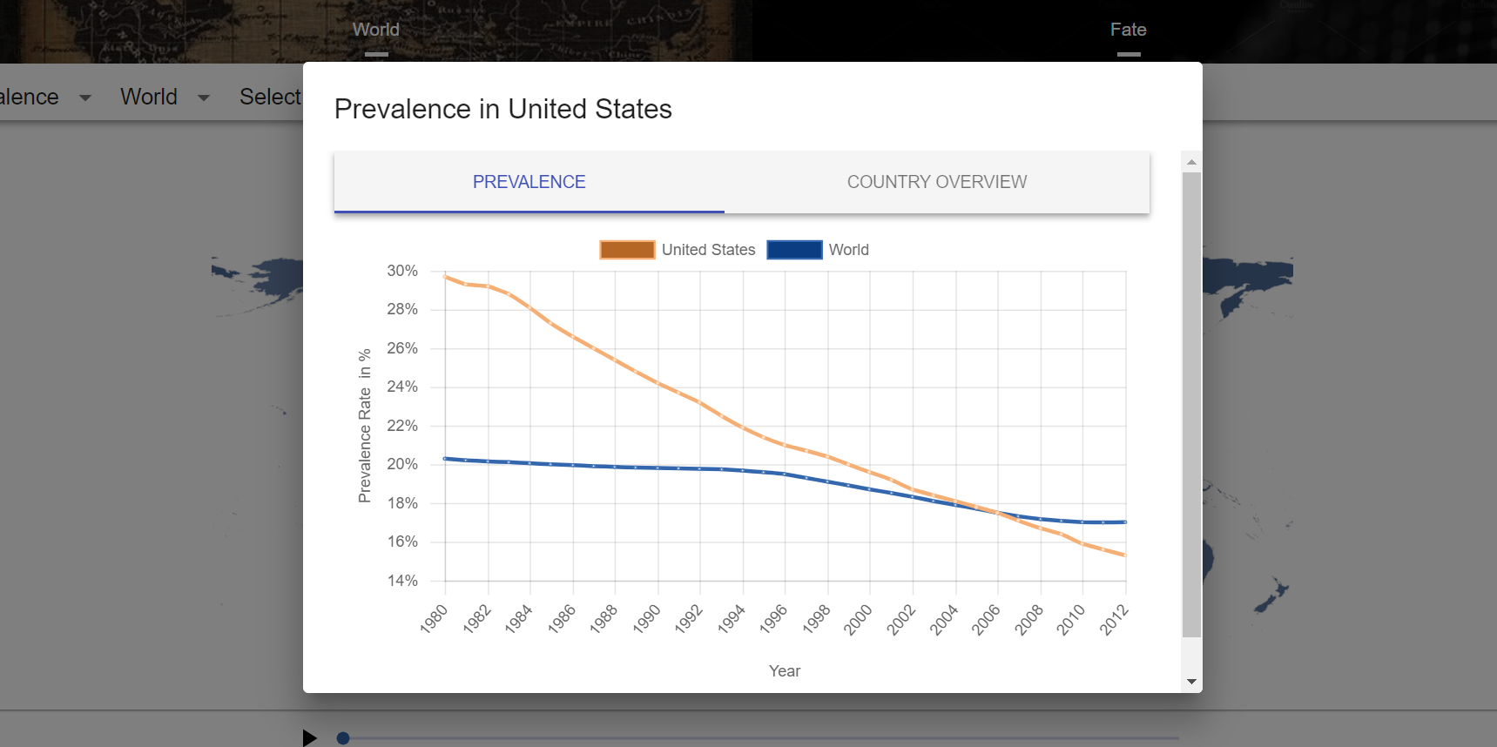
Click to show country overview
Legends. Press to toggle hide or unhide.
The graph is a comparison between a single country’s and world’s trend.

Slide 6
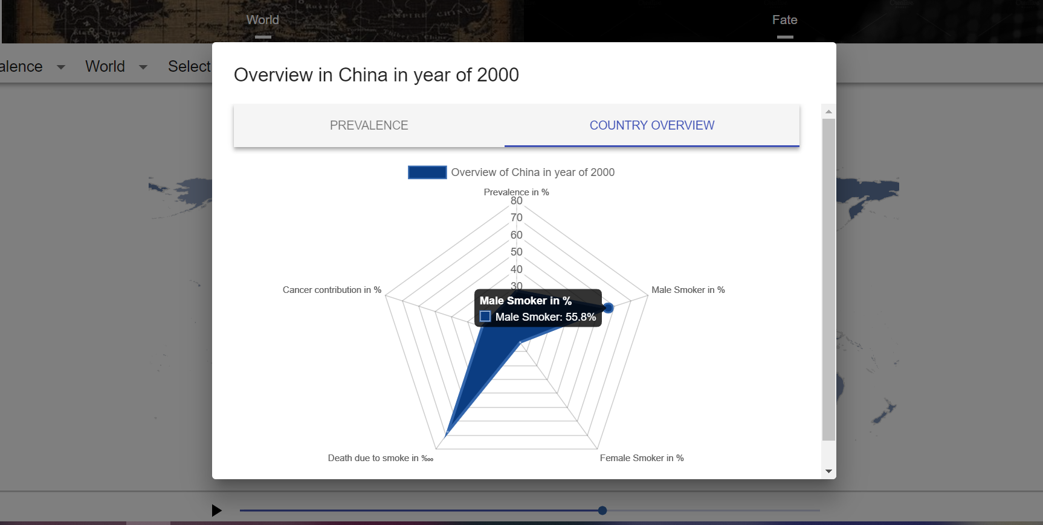
This radar map shows the overview of the country in a specific year.

Slide 7
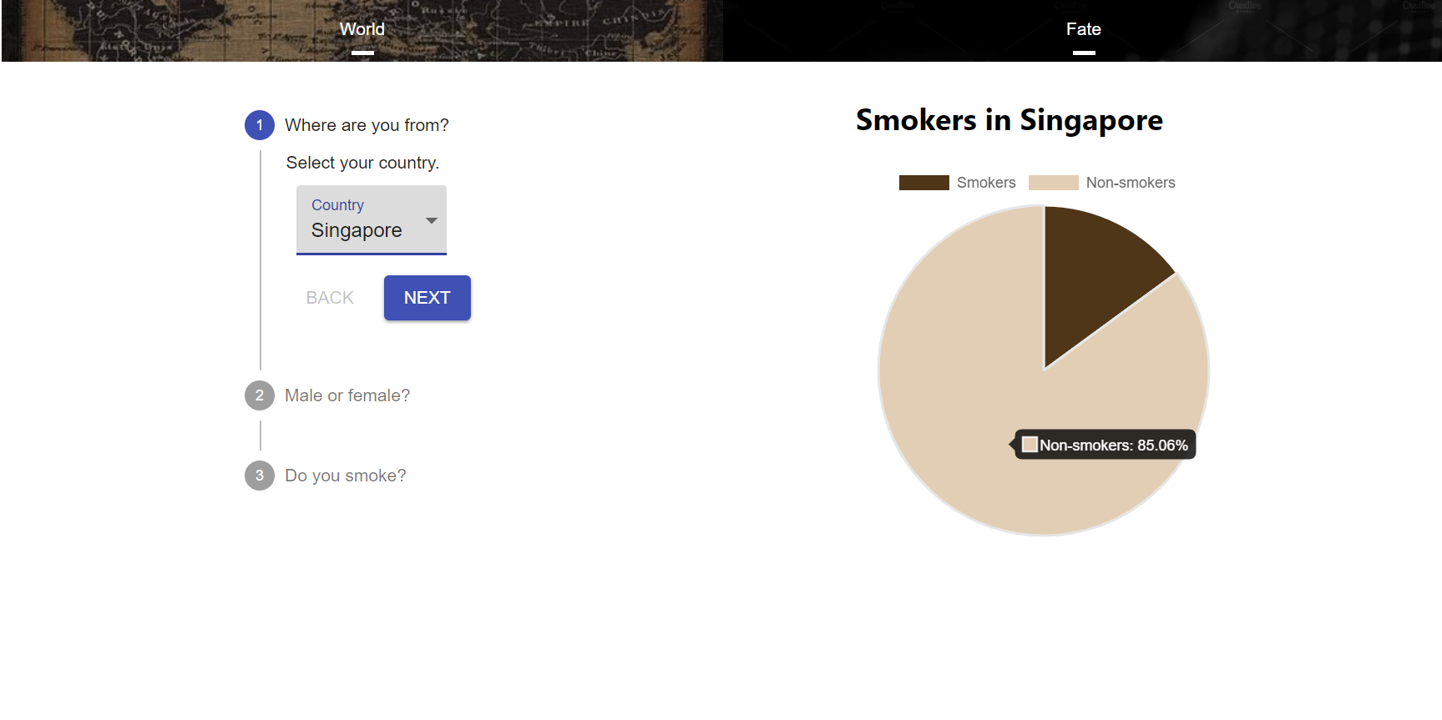
Select country, the pie chart will show the smoker percentage in the country

Slide 8
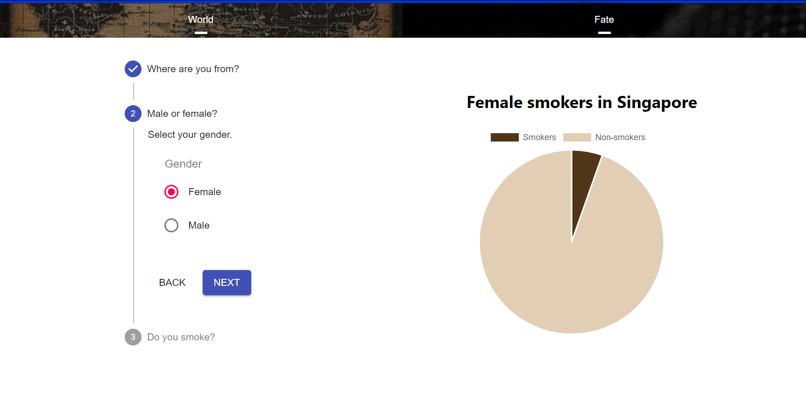
Select gender, the pie chart will display the smoker percentage of the selected gender in the selected year.

Slide 9
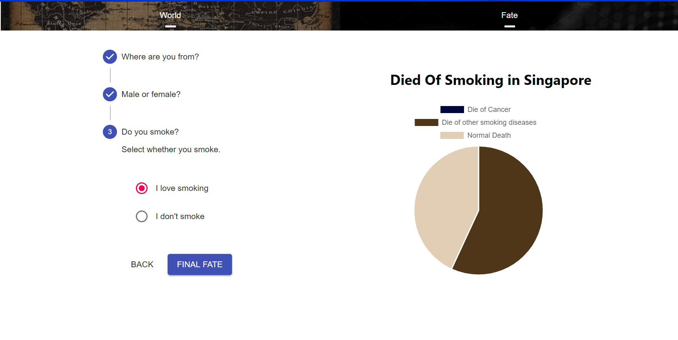
Select if you are currently a smoker
If “I love smoking” is selected, the pie char displays the possibility of death due to smoking-related diseases.

Slide 10
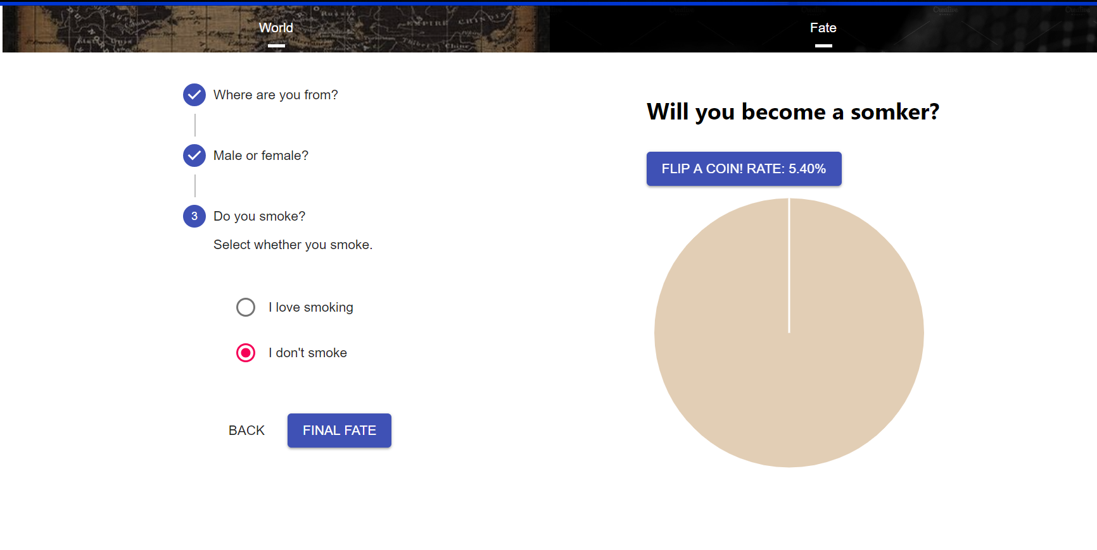
If “I don‘t smoke” is selected, press the button to simulate whether you will become a smoker.

Slide 11
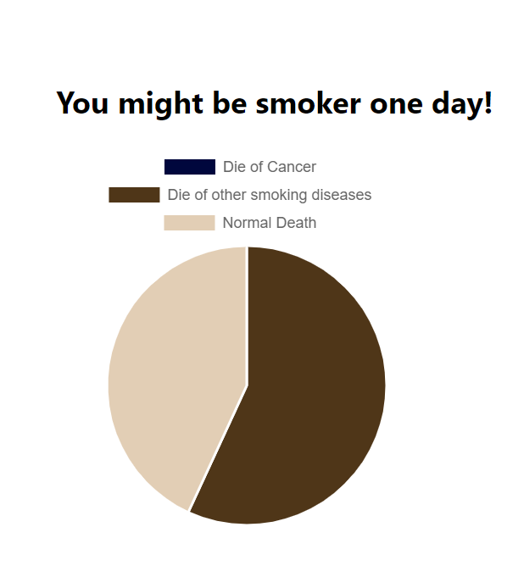
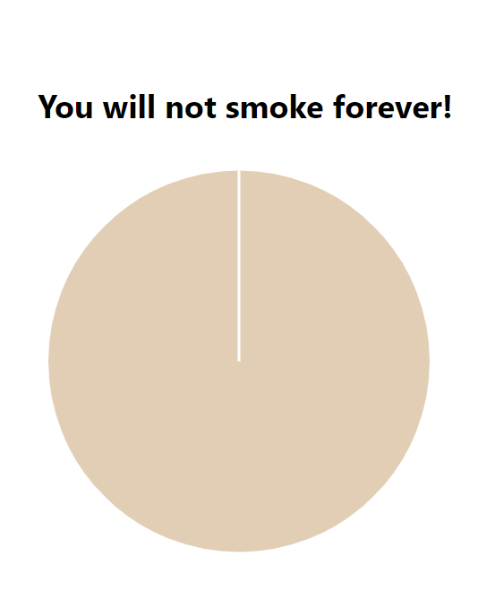
There will be two possible outcomes.

